Slide 1
KRISHI-VIKAS A Farming Management System
Presented by :-
Name :- Hitesh Bemal
Reg.No :- 22352026
Dept :- Computer Science
Course :- M.C.A Guided by :- Dr. S.Ravi

Slide 2

Introduction
The farming management system is a revolutionary platform designed to streamline agricultural transactions.
Facilitates seamless interactions between farmers and buyers.
Modernizes the farming industry by providing a comprehensive and efficient solution for online transactions.
A blend of frontend and backend technologies creates a well-rounded and user-friendly interface.
The system stands out with its utilization of SQLALchemy, ensuring efficient data management.

Slide 3
Technologies Used
Frontend Development:
HTML & CSS: Core building blocks for website structure and styling.
JavaScript: Adds interactivity and dynamic elements.
Bootstrap: Responsive framework for mobile-friendly design.
Backend Development:
Python & Flask: Powerful and popular combo for building server-side applications.
SQLAlchemy: Object-relational mapper for efficient database interaction.
Database Management:
MySQL: Robust and widely used relational database system.
XAMPP: Local development server for testing and deployment.

Slide 4
System Features
For Farmers:
Create profiles and showcase their produce.
Upload product details and prices.
Communicate directly with buyers and receive payments securely.
For Buyers:
Browse through a wide variety of agricultural products.
Place orders.
Securely manage payments and review purchases.

Slide 5
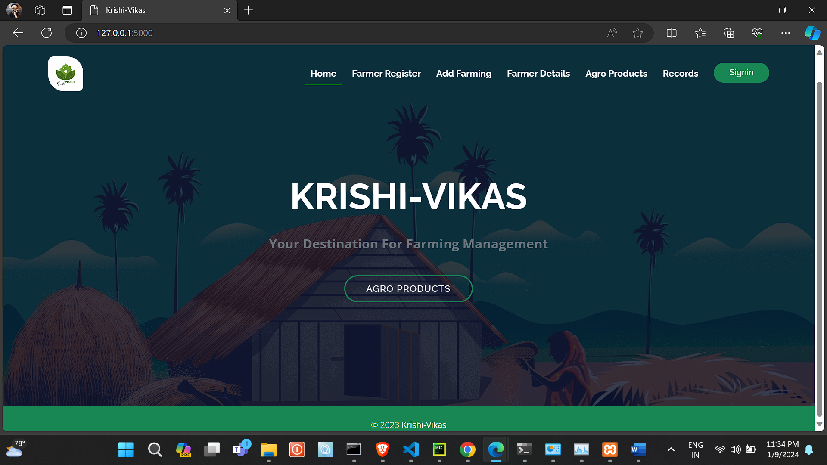
User Interface
Add types of farming
All products displays
Home page
Farmer can register here
User can see all records
Farmer can see the details
Login/signup page

Slide 6
Data Management
Robust Database: MySQL, a secure and reliable relational database, is used to store and manage data effectively.
Structured Organization: Each entity (farmers, buyers, products) has its dedicated table, ensuring data integrity and clear organization.
Secure Access: User roles and permissions control data access.
System Optimization: These insights can guide system enhancements and optimization, further improving efficiency and value for users.

Slide 7
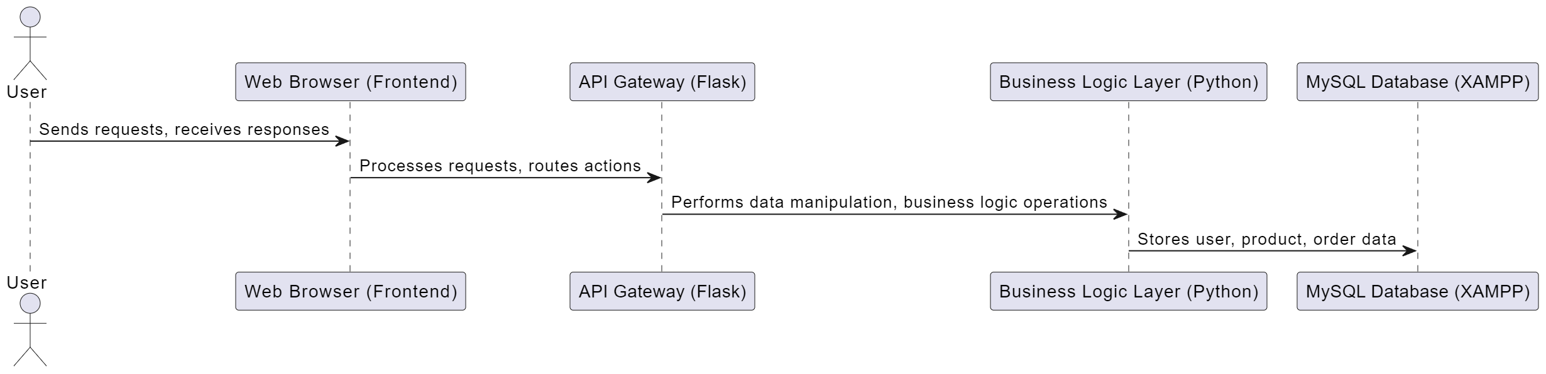
System Architecture
Data Flow :-
User interacts with the frontend (web browser).
Frontend sends a request to the API Gateway.
API Gateway routes the request to the appropriate backend service.
Backend service interacts with the Business Logic Layer.
Business Logic Layer performs business operations, often querying or updating the database.
Business Logic Layer sends a response back to the API Gateway.
API Gateway sends the response back to the frontend.
Frontend displays the response to the user.

Slide 8
Future Prospects
Scalability: Future enhancements may include the expansion of product categories and user base.
Integration with Emerging Technologies: Potential incorporation of AI for predictive analytics and smart farming features.
Enhanced User Features:Feedback mechanisms, personalized dashboards, and real-time notifications are potential additions.
Payment Integration :- able to pay through QR code, Online banking etc.

Slide 9
Demo Of the Project

Slide 10

Conclusion
This system is not just a platform; it's a catalyst for change.
Equipping farmers and buyers with the power of technology.
we can reshape the agricultural landscape into one that is prosperous, equitable, and sustainable.
The future of agribusiness is here, and it's digital.

Slide 11
Thank You

